Slide 1
CLASSROOM RULES
Be on time
Be interactive
100% or nothing
Do all daily challenges

Slide 2

Lesson 17:
Conjunctions
Brought to you by LangGo

Slide 3
REVIEW:
GRAMMAR + VOCABULARY

Slide 4
REVIEW: LISTENING
What do you usually have for dinner?
I try to eat healthy, so I usually cook vegetables.
It's so much easier to drive.
Do you have good computer skills?
Are you good at typing?
I speak Spanish very fluently.
I drive safely. I never speed.
When I want to relax, I usually play games on my phone.
I'm sure I'll get used to it and I'll make it feel like home.

Slide 5
REVIEW: SPEAKING
REVIEW ALL THE SPEAKING TOPICS YOU HAVE LEARNT.

Slide 6
Objectives
01
02
03
Definition of conjunction
Types of conjunctions
Practice

Slide 7
01
Definition of conjunction

Slide 8
What is “conjunction”?
I love my hometown, for it is peaceful.
My hometown has many parks, and it has a beautiful river.
You can walk by the lake, or you can ride a bike in the countryside.

Slide 9
What is “conjunction”?
A conjunction is a word which connects:
Two words
Two phrases
Two clauses
and shows the relation between them

Slide 10


Conjunctions are used to:
Avoid making the text seem like bullet points.
Make the text flow.

Slide 11
02
Types of conjunctions

Slide 12
Types of conjunctions
1
2
3
Coordinating
conjunctions
Subordinating
conjunctions
Correlative
conjunctions

Slide 13
Coordinating conjunctions
Food and water are important.
We ran after him, but he escaped.
🡪 link or join two words or phrases that are equally important

Slide 14
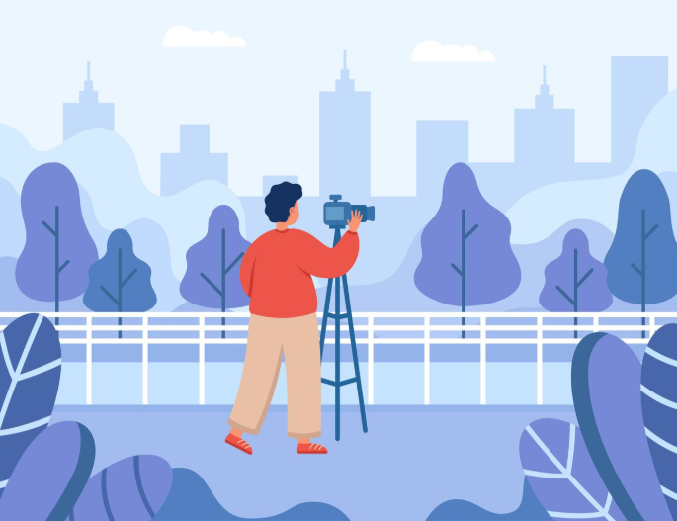
Common coordinating conjunctions
For (= because)
People often visit my hometown, for it has beautiful views.
🡪 Reason/ Cause

Slide 15
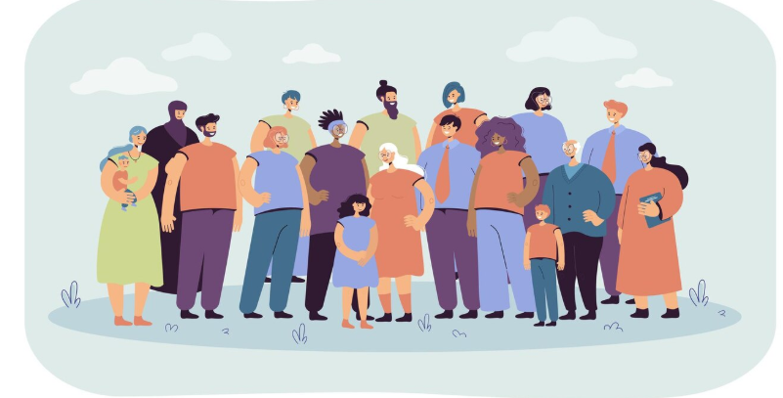
Common coordinating conjunctions
And (= in addition to)
What I like about my hometown is that the people are friendly, and the weather is usually nice.
🡪 Addition

Slide 16
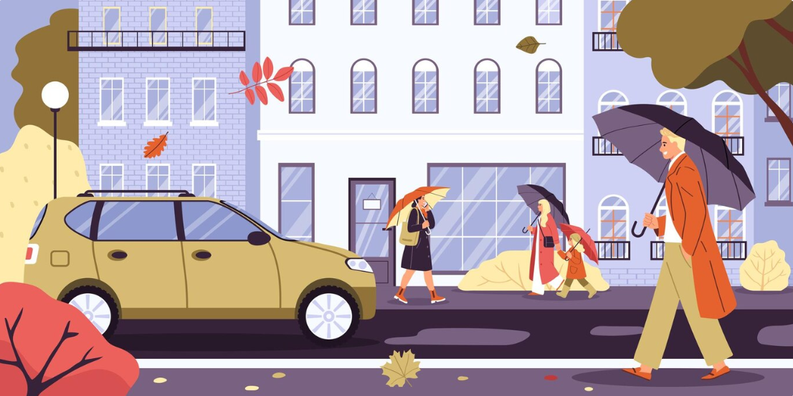
Common coordinating conjunctions
Nor (= and not)
My neighborhood doesn’t have traffic jams, nor does it have noisy streets.
🡪 Negative choice

Slide 17
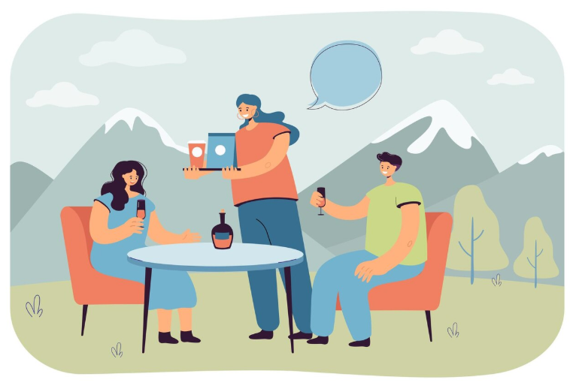
Common coordinating conjunctions
But (= However)
It’s a quiet town, but there are still fun things to do.
🡪 Contrast

Slide 18
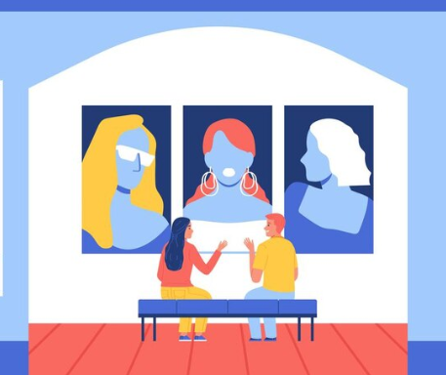
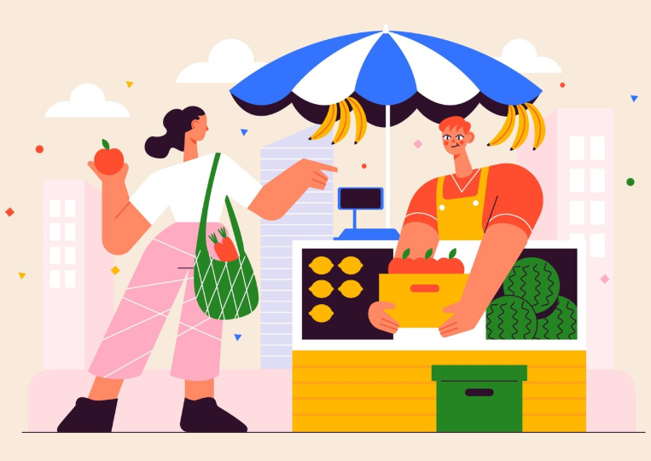
Common coordinating conjunctions
Or (= Either ... or)
You can visit the museum, or you can explore the old town market.
🡪 Choices/options

Slide 19
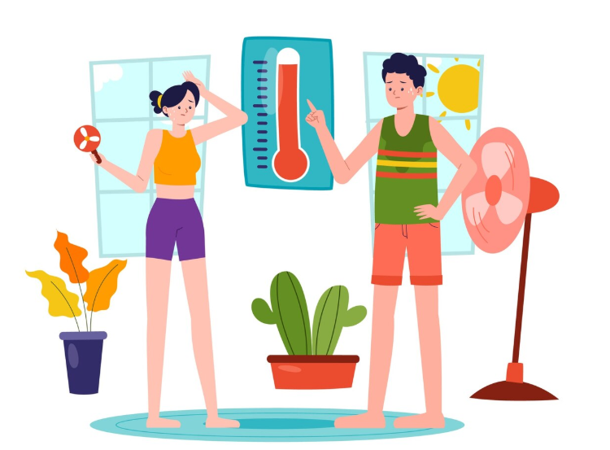
Common coordinating conjunctions
Yet (= But)
It’s usually very hot in the summer, yet many people still enjoy walking around and eating at night.
🡪 Contrast

Slide 20
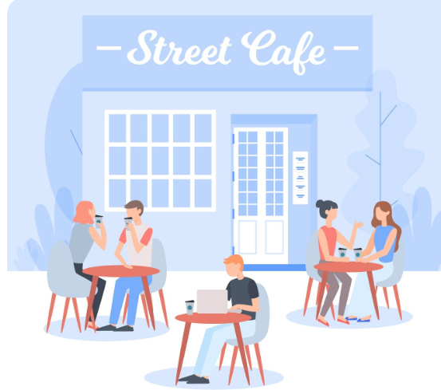
Common coordinating conjunctions
So (= Therefore)
There are lots of cafés and shops in my hometown, so tourists always have places to relax and enjoy local food.
🡪 Result

Slide 21
F
A
N
B
O
Y
S
or
Reason/ Cause
nd
Addition
or
Negative choice
ut
Contrast
r
Choices/ Options
et
Contrast
Result
o

Slide 22

PRACTICE

Slide 23
CONTRAST
A
B
My hometown is far from the city
I don’t mind
My hometown is far from the city, but I don’t mind.

Slide 24
RESULT
A
B
My hometown is near the sea
Many people go fishing
My hometown is near the sea, so many people go fishing.

Slide 25
REASON/CAUSE
A
B
I enjoy living here
it is calm and safe.
I enjoy living here, for it is calm and safe.

Slide 26
CHOICE
A
B
Visitors can join a village tour
They can explore on their own
Visitors can join a village tour, or they can explore on their own.

Slide 27
Correlative conjunctions
Both the river and the mountains make my hometown beautiful.
There is neither a shopping mall nor a cinema in my hometown.
🡪 PAIRS of conjunctions
🡪 Join different words or groups of words in a sentence together
🡪 NOT used to link sentences themselves

Slide 28
CONJUNCTIONS | EXAMPLES
Both…and… | This house is both large and warm.
Either… or… | You should put it either on the left or on the right.
Neither…nor… | He is neither rich nor famous.
Not only… but also… | My father is not only friendly but also kind.
Rather… than…. | She’d rather play the piano than sing.
X
X
X
X
X

Slide 29
REVIEW – TYPES OF CONJUNCTIONS
Coordinating
Correlative
Use to link or join two words or phrases that are equally important
Examples:
For, And, Nor, But, Or, Yet, So
They are pairs of conjunctions used in a sentence to join different words or phrases in a sentence together
Examples:
Both-and; Either-or; Not only-but also; etc.
F-A-N-B-O-Y-S

Slide 30
Fill in the blanks with the correct pairs of correlative conjunctions:
MY HOMETOWN
My hometown is beautiful. It has ___ rivers ___ mountains. The view is always fantastic, ___ in the morning ___ in the evening. Moreover, ___ is the air clean, ___ the weather is nice all year round. ___ the streets ___ the markets are crowded, so you can ___ walk through the rice fields ___ take a bike ride along the river. You should visit this place sometime!

Slide 31
MY HOMETOWN
My hometown is beautiful. It has both rivers and mountains. The view is always fantastic, both in the morning and in the evening. Moreover, not only is the air clean, but also the weather is nice all year round. Neither the streets nor the markets are crowded, so you can either walk through the rice fields or take a bike ride along the river. You should visit this place sometime!

Slide 32
03
Speaking

Slide 33
Describe your hometown:
1. Where is your hometown?
My hometown is in the north/south of Vietnam..
It is near the mountains / river / sea.
It is not far from the city.
2. What is your hometown like?
It is beautiful and peaceful.
It has both rivers and mountains.
The view is fantastic not only in the morning but also in the evening.
My hometown is small, but it is very beautiful.
It has not only beautiful views, but also friendly people.

Slide 34
3. What do you like about it?
The air is clean, so I enjoy living there.
The streets are not crowded, and the people are friendly.
I don’t like big cities, nor do I like noisy places.
I love my hometown, for it is peaceful and safe.
4. What can people do there?
People can go for a walk, ride a bike, or enjoy the view.
You can either visit the local markets or explore the nature.
It is a quiet town, yet it has many things to do.
5. Is there anything you dislike about your hometown?
It’s very hot in the summer, and there are not many trees, so it feels even hotter.
Neither the bus station nor the train station is close to my house, so I have to walk there.
There are too many cars, and the roads are narrow.

Slide 35
LET’S PRACTICE SPEAKING
1. Where do you come from?
2. What do you like about your hometown?
3. Is there anything you dislike about your hometown?
4. Are there any lakes or rivers/woods or forests/hills or mountains in your hometown?

Slide 36

GOODBYE!

